Slide 1

Hangquan Qian
Yuxiang Huang
Jin Dong

Slide 2
UEFA Champions League knockout
Background
16 Clubs
Assumption
Simulation Method
Pitfalls
Results
Confidence Interval / percentile
Validation
Questions

Slide 3
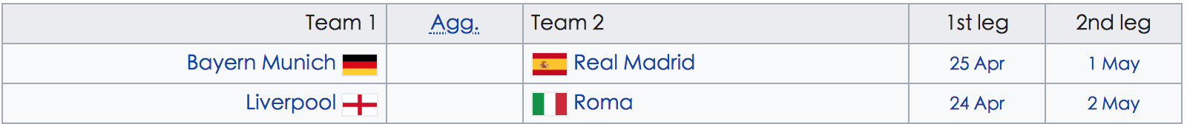
Background
The 2017 – 2018 UEFA Champions League Knockout phase began on 13 February and will end on 26 May 2018 with the final at the NSC Olimpiyskiy Stadium in Kiev, Ukraine, to decide the champions of the 2017 – 2018 UEFA Champions League. A total of 16 teams compete in Knockout phase.
Group Matches 4*8
Tournament 16 → 8 → 4 → 2→ 1

Slide 4
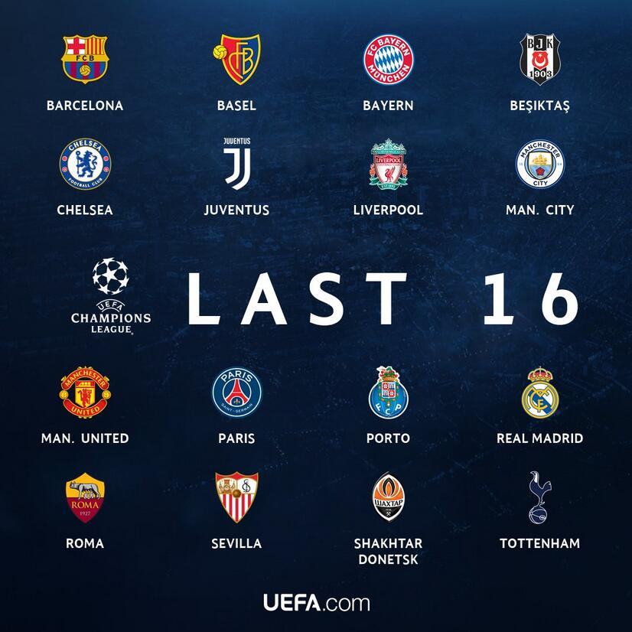
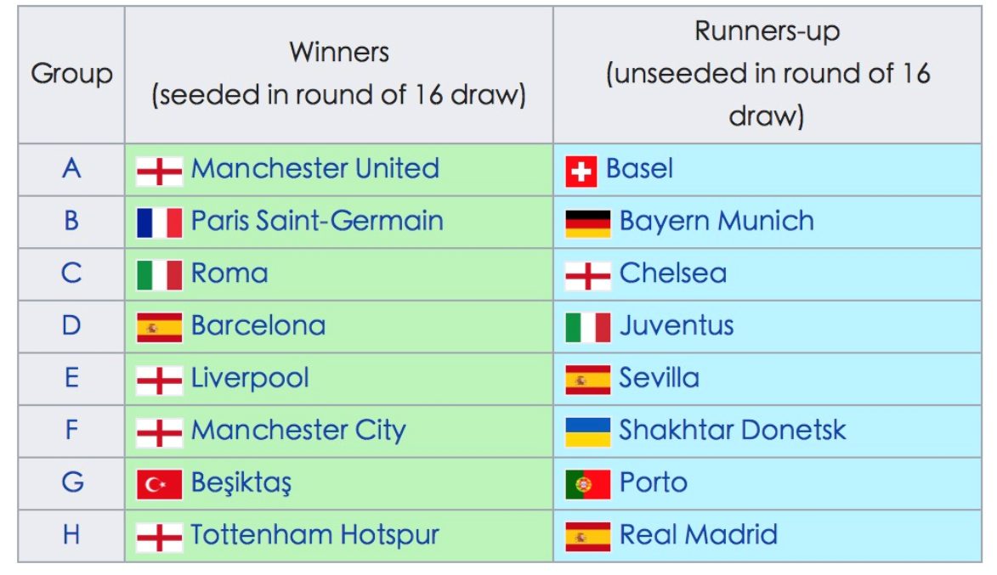
16 Clubs

Slide 5
Assumption
Python could randomly select
No Cheating in games, fairness
Rules: 1# cannot be same group
2# cannot be same country
3+1+1(Champion of Europa League)

Slide 6
Simulation---Overview
Initialize 8X8 matrix with zeros
Procedure:
First Round: Randomly select one team from 1st ranking group, select his competitor, and increase the value in its matching cell by 1
Second Round：Randomly select one team in remaining 1st ranking pool, select his competitor, and increase the value in its matching cell by 1
Repeat: All teams finds their competitors --- Eight Rounds
Repeat 100, 000 times
Probability = Total value / 100, 000

Slide 7
Simulation --- Initialization
Rank 2 Rank 1 | A Basel (Switzerland) | B Bayern Munich (Germany) | C Chelsea (England) | D Juventus (Italy) | E Sevilla (Spain) | F Shakhtar Donetsk (Ukraine) | G Porto (Portugal) | H Real Madrid (Spain)
A Manchester United (England) | 0 | 0 | 0 | 0 | 0 | 0 | 0 | 0
B Paris Saint-Germain (France) | 0 | 0 | 0 | 0 | 0 | 0 | 0 | 0
C Roma (Italy) | 0 | 0 | 0 | 0 | 0 | 0 | 0 | 0
D Barcelona (Spain) | 0 | 0 | 0 | 0 | 0 | 0 | 0 | 0
E Liverpool (England) | 0 | 0 | 0 | 0 | 0 | 0 | 0 | 0
F Manchester City (England) | 0 | 0 | 0 | 0 | 0 | 0 | 0 | 0
G Besiktas (Turkey) | 0 | 0 | 0 | 0 | 0 | 0 | 0 | 0
H Tottenham Hotspur (England) | 0 | 0 | 0 | 0 | 0 | 0 | 0 | 0

Slide 8
Simulation --- Randomly Select
Rank 2 Rank 1 | A Basel (Switzerland) | B Bayern Munich (Germany) | C Chelsea (England) | D Juventus (Italy) | E Sevilla (Spain) | F Shakhtar Donetsk (Ukraine) | G Porto (Portugal) | H Real Madrid (Spain)
A Manchester United (England) | X | 1 | 0 | 0 | 0 | 0 | 0 | 0
B Paris Saint-Germain (France) | 0 | X | 0 | 0 | 0 | 0 | 0 | 0
C Roma (Italy) | 0 | 0 | X | 0 | 0 | 0 | 0 | 0
D Barcelona (Spain) | 0 | 0 | 1 | X | 0 | 0 | 0 | 0
E Liverpool (England) | 0 | 0 | 0 | 0 | X | 0 | 0 | 0
F Manchester City (England) | 0 | 0 | 0 | 0 | 0 | X | 0 | 0
G Besiktas (Turkey) | 0 | 0 | 0 | 0 | 0 | 0 | X | 0
H Tottenham Hotspur (England) | 0 | 0 | 0 | 0 | 0 | 0 | 0 | X

Slide 9

Simulation --- Repeat & Probability
Rank 2 Rank 1 | A Basel (Switzerland) | B Bayern Munich (Germany) | C Chelsea (England) | D Juventus (Italy) | E Sevilla (Spain) | F Shakhtar Donetsk (Ukraine) | G Porto (Portugal) | H Real Madrid (Spain)
A Manchester United (England) | X | 2000/100000 | 0 | 0 | 0 | 0 | 0 | 0
B Paris Saint-Germain (France) | 0 | X | 0 | 0 | 0 | 0 | 0 | 0
C Roma (Italy) | 0 | 0 | X | 0 | 0 | 0 | 0 | 0
D Barcelona (Spain) | 0 | 0 | 1850/100000 | X | 0 | 0 | 0 | 0
E Liverpool (England) | 0 | 0 | 0 | 0 | X | 0 | 0 | 0
F Manchester City (England) | 0 | 0 | 0 | 0 | 0 | X | 0 | 0
G Besiktas (Turkey) | 0 | 0 | 0 | 0 | 0 | 0 | X | 0
H Tottenham Hotspur (England) | 0 | 0 | 0 | 0 | 0 | 0 | 0 | X
Repeat:
n = 100,000
Probability:
P=total # / n

Slide 10

Simulation
There are three pitfalls!!

Slide 11
Pitfalls
1# After 7 rounds, two remaining teams will automatically become competitors.
2# For each step of simulation between round 3 and round 6 , team k from 1st-ranking group may have only one choice.
Rules: X same group, X same country
3# For each step of simulation between round 3 and round 6, team k from 2nd-ranking group, it may have only one choice.

Slide 12
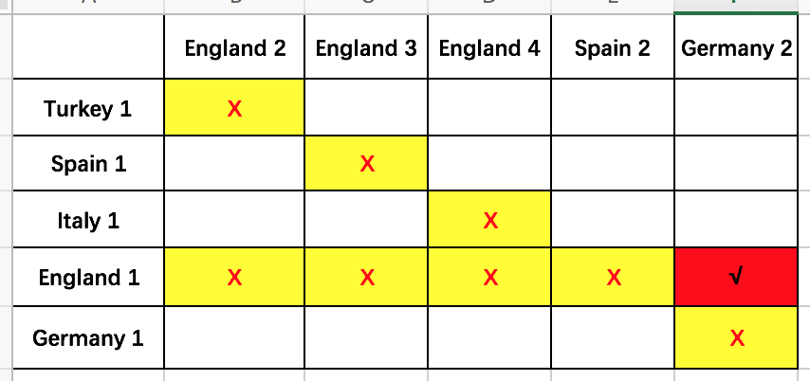
Pitfall-2

Slide 13
Pitfalls
Rank 2 Rank 1 | A Basel (Switzerland) | B Bayern Munich (Germany) | C Chelsea (England) | D Juventus (Italy) | E Sevilla (Spain) | F Shakhtar Donetsk (Ukraine) | G Porto (Portugal) | H Real Madrid (Spain)
A Manchester United (England) | X | 0 | X | 1 | 0 | 0 | 0 | 0
B Paris Saint-Germain (France) | 0 | X | X | 0 | 0 | 0 | 0 | 1
C Roma (Italy) | 1 | 0 | X | 0 | 0 | 0 | 0 | 0
D Barcelona (Spain) | 0 | 0 | 1 | X | 0 | 0 | 0 | 0
E Liverpool (England) | 0 | 0 | X | 0 | X | 0 | 0 | 0
F Manchester City (England) | 0 | 0 | X | 0 | 0 | X | 0 | 0
G Besiktas (Turkey) | 0 | 1 | X | 0 | 0 | 0 | X | 0
H Tottenham Hotspur (England) | 0 | 0 | X | 0 | 0 | 0 | 0 | X

Slide 14
Adjusted Simulation
Initialize 8X8 matrix with zeros
Procedure:
First Round: Randomly select one team from 1st ranking group, select his competitor, and increase the value in its matching cell by 1
Second Round：Randomly select one team in remaining 1st ranking pool, select his competitor, and increase the value in its matching cell by 1
Round three – Round seven: repeat first two rounds, but check pitfall 2 and pitfall 3
Repeat 100, 000 times
Probability = Total value / 100, 000

Slide 15
Results
Rank 2 Rank 1 | A Basel (Switzerland) | B Bayern Munich (Germany) | C Chelsea (England) | D Juventus (Italy) | E Sevilla (Spain) | F Shakhtar Donetsk (Ukraine) | G Porto (Portugal) | H Real Madrid (Spain)
A Manchester United (England) | 0 | 0.16577 | 0 | 0.163772 | 0.161622 | 0.167973 | 0.16977 | 0.171105
B Paris Saint-Germain (France) | 0.161007 | 0 | 0.162547 | 0.13262 | 0.131134 | 0.13721 | 0.135911 | 0.139575
C Roma (Italy) | 0.185853 | 0.186221 | 0 | 0 | 0.152342 | 0.157827 | 0.156901 | 0.160851
D Barcelona (Spain) | 0.20058 | 0.197149 | 0.267468 | 0 | 0 | 0.169027 | 0.165776 | 0
E Liverpool (England) | 0.152437 | 0.151729 | 0 | 0.241665 | 0 | 0.129596 | 0.129762 | 0.19481
F Manchester City (England) | 0.122058 | 0.122311 | 0 | 0.192922 | 0.230219 | 0 | 0.105322 | 0.227169
G Besiktas (Turkey) | 0.052038 | 0.051095 | 0.569984 | 0.071021 | 0.079985 | 0.069399 | 0 | 0.106489
H Tottenham Hotspur (England) | 0.126038 | 0.125718 | 0 | 0.197999 | 0.244705 | 0.168976 | 0.136558 | 0

Slide 16
Confidence Interval
Rank 2 Rank 1 | A Basel (Switzerland) | B Bayern Munich (Germany) | C Chelsea (England) | D Juventus (Italy) | E Sevilla (Spain) | F Shakhtar Donetsk (Ukraine) | G Porto (Portugal) | H Real Madrid (Spain)
A Manchester United (England) | 0 | [0.1651,0.1665] | 0 | [0.1631,0.1644] | [0.1609,0.1623] | [0.1673,0.1687] | [0.1690,0.1705] | [0.1703,0.1719]
B Paris Saint-Germain (France) | [0.1603,0.1617] | 0 | [0.1618,0.1633] | [0.1319,0.1333] | [0.1305,0.1318] | [0.1365,0.1379] | [0.1352,0.1366] | [0.1388,0.1403]
C Roma (Italy) | [0.1851,0.1866] | [0.1854,0.1870] | 0 | 0 | [0.1516,0.1531] | [.1571,0.1586] | [0.1563,0.1575] | [0.1601,0.1616]
D Barcelona (Spain) | [0.1998,0.2014] | [0.1963,0.1980] | [0.2665,0.2685] | 0 | 0 | [0.1683,0.1698] | [0.1650,0.1666] | 0
E Liverpool (England) | [0.1517,0.1532] | [0.1510,0.1525] | 0 | [0.2408,0.2425] | 0 | [0.1289,0.1303] | [0.1291,0.1304] | [0.1940,0.1956]
F Manchester City (England) | [0.1214,0.1227] | [0.1217,0.1229] | 0 | [0.1921,0.1938] | [0.2293,0.2312] | 0 | [0.1047,0.1059] | [0.2264,0.2280]
G Besiktas (Turkey) | [0.0516,0.0525] | [0.0507.0.0515] | [0.5688,0.5712] | [0.0705,0.0716] | [0.0794,0.0806] | [0.0688,0.0700] | 0 | [0.1059,0.1071]
H Tottenham Hotspur (England) | [0.1253.0.1267] | [0.1250,0.1264] | 0 | [0.1972.0.1988] | [0.2440,0.2455] | [0.1682,0.1698] | [0.1359,0.1373] | 0

Slide 17
1% and 99% Percentile
 | A Basel (Switzerland) |  | B Bayern Munich (Germany) |  | C Chelsea (England) |  | D Juventus (Italy) |  | E Sevilla (Spain) |  | F Shakhtar Donetsk (Ukraine) |  | G Porto (Portugal) |  | H Real Madrid (Spain)
 | 1% | 99% | 1% | 99% | 1% | 99% | 1% | 99% | 1% | 99% | 1% | 99% | 1% | 99% | 1% | 99%
A Manchester United (England) | 0 | 0 | 0.1587 | 0.1794 | 0 | 0 | 0.151 | 0.1729 | 0.1539 | 0.1679 | 0.1593 | 0.1758 | 0.1627 | 0.1811 | 0.1606 | 0.1827
B Paris Saint-Germain (France) | 0.1519 | 0.1695 | 0 | 0 | 0.1541 | 0.1753 | 0.1244 | 0.1407 | 0.1243 | 0.1394 | 0.1288 | 0.1457 | 0.1282 | 0.1448 | 0.1305 | 0.1474
C Roma (Italy) | 0.1766 | 0.1985 | 0.1735 | 0.1987 | 0 | 0 | 0 | 0 | 0.1421 | 0.1627 | 0.1472 | 0.1677 | 0.1489 | 0.1663 | 0.1512 | 0.1712
D Barcelona (Spain) | 0.191 | 0.2095 | 0.1854 | 0.2098 | 0.2571 | 0.2815 | 0 | 0 | 0 | 0 | 0.1618 | 0.1782 | 0.1561 | 0.1767 | 0 | 0
E Liverpool (England) | 0.1406 | 0.1642 | 0.1398 | 0.1589 | 0 | 0 | 0.2313 | 0.2512 | 0 | 0 | 0.1193 | 0.1376 | 0.1217 | 0.1373 | 0.187 | 0.2048
F Manchester City (England) | 0.1149 | 0.1283 | 0.1138 | 0.1314 | 0 | 0 | 0.1845 | 0.2038 | 0.2191 | 0.2406 | 0 | 0 | 0.098 | 0.1147 | 0.214 | 0.237
G Besiktas (Turkey) | 0.0474 | 0.0577 | 0.0465 | 0.0556 | 0.5541 | 0.5868 | 0.0643 | 0.0769 | 0.0731 | 0.0872 | 0.0621 | 0.0769 | 0 | 0 | 0.0984 | 0.1164
H Tottenham Hotspur (England) | 0.1191 | 0.1328 | 0.1146 | 0.1348 | 0 | 0 | 0.1895 | 0.2076 | 0.2336 | 0.258 | 0.161 | 0.1807 | 0.1262 | 0.1461 | 0 | 0
Rank2
Rank1

Slide 18
Validation
Compare with bracket
Compare with odds
Validate with past results

Slide 19
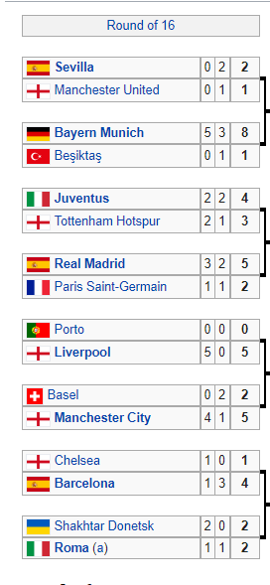
Compare with Bracket
Rank 2 Rank 1 | A Basel (Switzerland) | B Bayern Munich (Germany) | C Chelsea (England) | D Juventus (Italy) | E Sevilla (Spain) | F Shakhtar Donetsk (Ukraine) | G Porto (Portugal) | H Real Madrid (Spain)
A Manchester United (England) | 0 | 0.16577 | 0 | 0.163772 | 0.161622 | 0.167973 | 0.16977 | 0.171105
B Paris Saint-Germain (France) | 0.161007 | 0 | 0.162547 | 0.13262 | 0.131134 | 0.13721 | 0.135911 | 0.140105
C Roma (Italy) | 0.185853 | 0.186221 | 0 | 0 | 0.152342 | 0.157827 | 0.156901 | 0.160851
D Barcelona (Spain) | 0.20058 | 0.197149 | 0.267468 | 0 | 0 | 0.169027 | 0.165776 | 0
E Liverpool (England) | 0.152437 | 0.151729 | 0 | 0.241665 | 0 | 0.129596 | 0.129762 | 0.19481
F Manchester City (England) | 0.122058 | 0.122311 | 0 | 0.192922 | 0.230219 | 0 | 0.105322 | 0.227169
G Besiktas (Turkey) | 0.052038 | 0.051095 | 0.569984 | 0.071021 | 0.079985 | 0.069399 | 0 | 0.106489
H Tottenham Hotspur (England) | 0.126038 | 0.125718 | 0 | 0.197999 | 0.244705 | 0.168976 | 0.136558 | 0

Slide 20
Compare with Odds
Manchester City | 1/4
Bayern Munich | 1/5.5
Paris Saint-Germain | 1/6
Barcelona | 1/8.5
Real Madrid | 1/9
Liverpool | 1/15
Manchester United | 1/15
Juventus | 1/17
Tottenham Hotspur | 1/28
Chelsea | 1/34

Slide 21
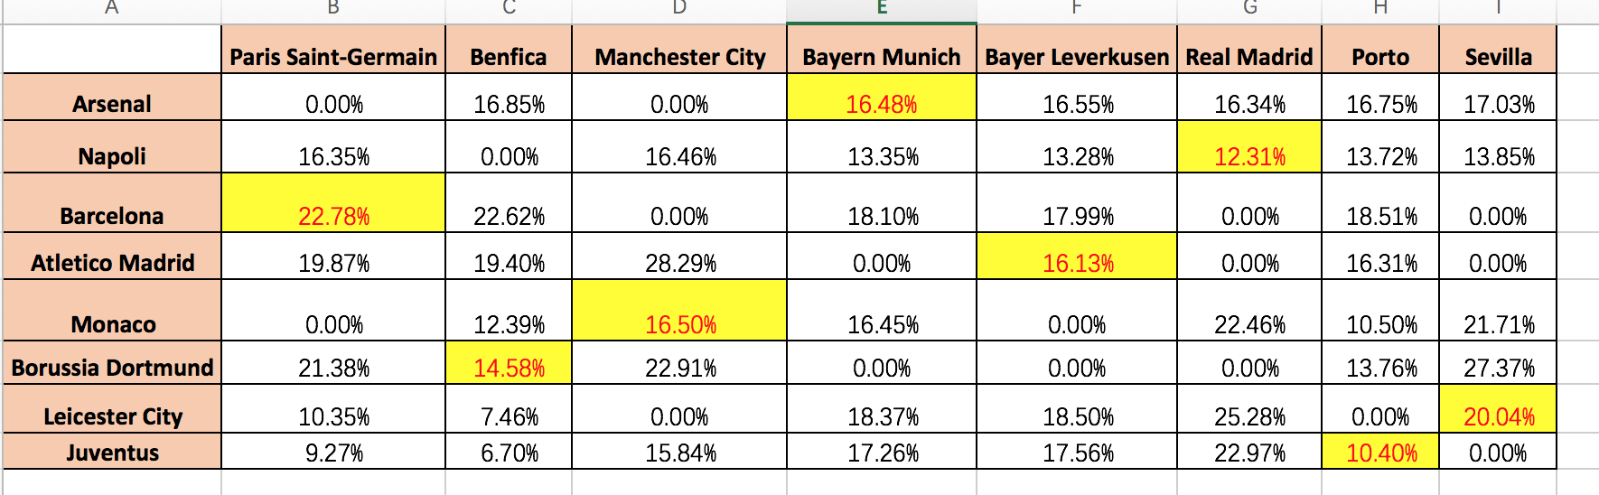
With past results, 2016 - 2017?
Inside Sport? Go to see FBI….

Slide 22

Q&A

Slide 23
Reference
https://en.wikipedia.org/wiki/2015%E2%80%9316_UEFA_Champions_League_knockout_phase
https://en.wikipedia.org/wiki/2016%E2%80%9317_UEFA_Champions_League_knockout_phase
https://en.wikipedia.org/wiki/2017%E2%80%9318_UEFA_Champions_League_knockout_phase
https://thesefootballtimes.co/2018/01/03/your-guide-to-the-champions-league-knockout-stages/

